Slide 1
Charged Weak Interactions of Quarks

Slide 2
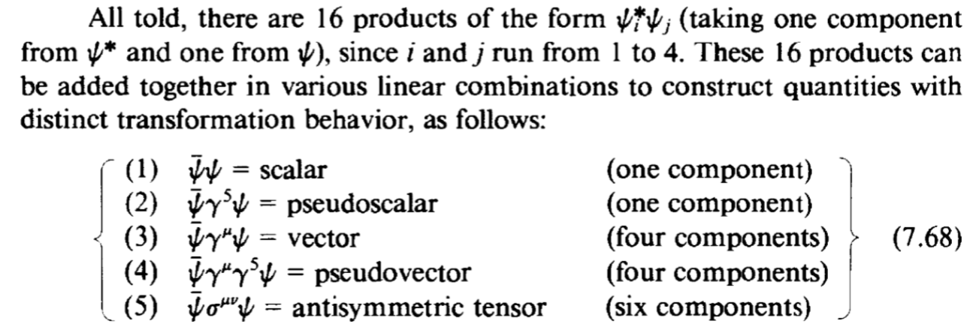
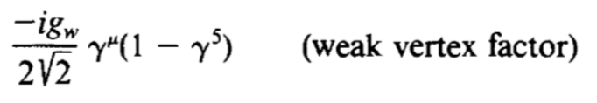
V-A Structure
Bilinear covariant
Axial vector
Interaction corresponding to spin1 particle is a linear combination of vector and axial-vector
V - A
Reason for helicity and parity violation

Slide 3
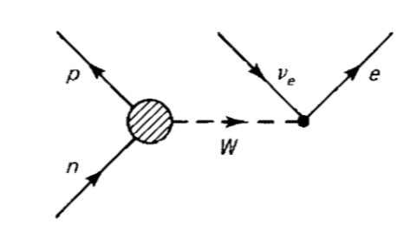


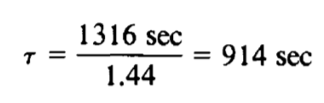

V-A Structure
Vertex is no clear
From many experiment,
Conserved Vector Current(CAC) Partially Conserved Axial Current(PCAC)
Cause a factor on lifetime

Slide 4
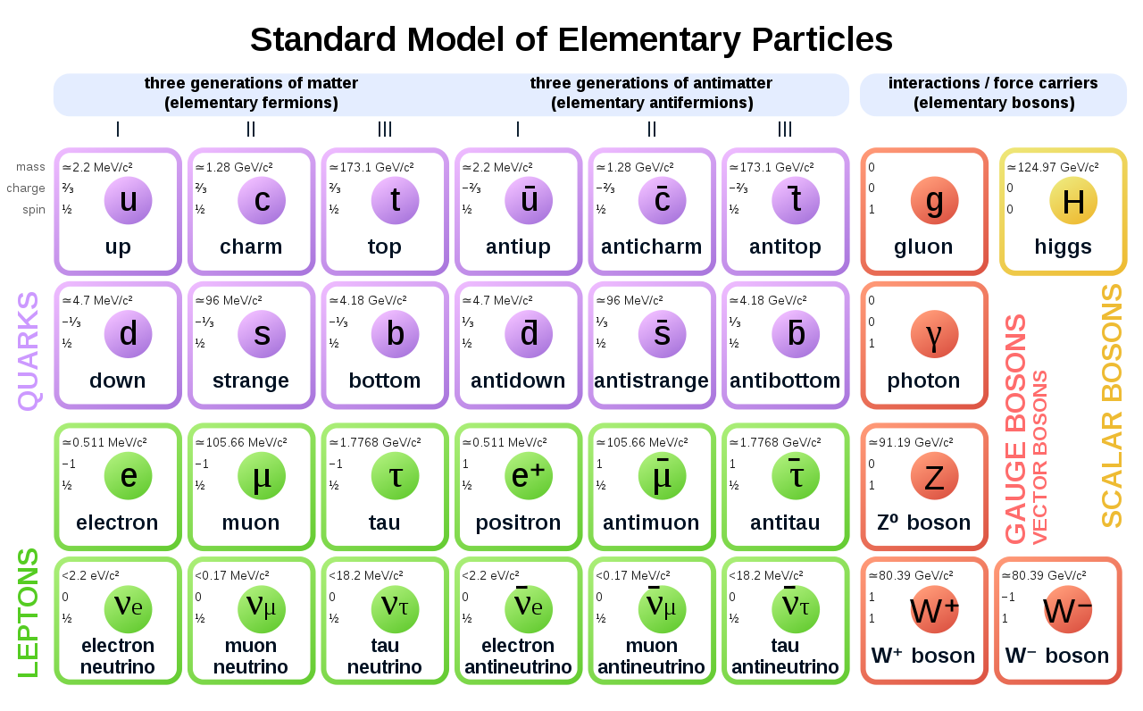
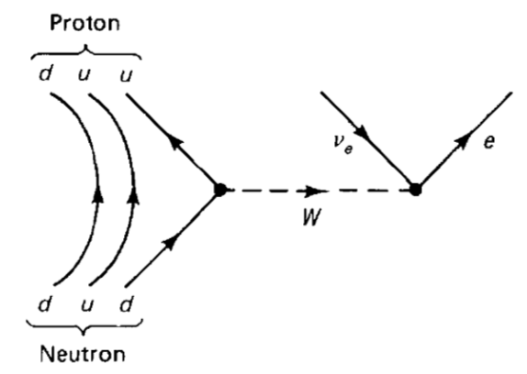
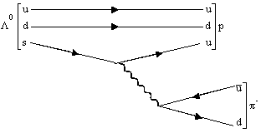




Weak interaction of Quarks
Lepton number conservation
Cross-generational coupling happens to quark
Weak interaction of leptons take place strictly within a generation

Slide 5
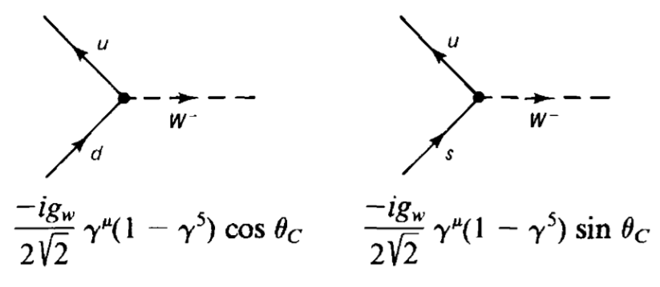

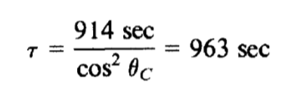
Cabibbo Angle
When coupling with quark, carries a factor
Generation changing one is weaker
Experimentally,
Cosθ=0.97 Sinθ=0.23
n lifetime

Slide 6
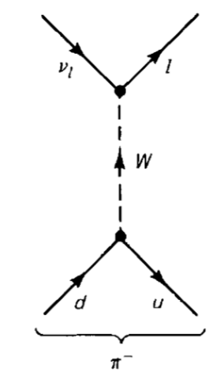
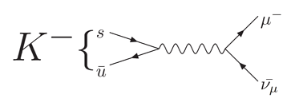
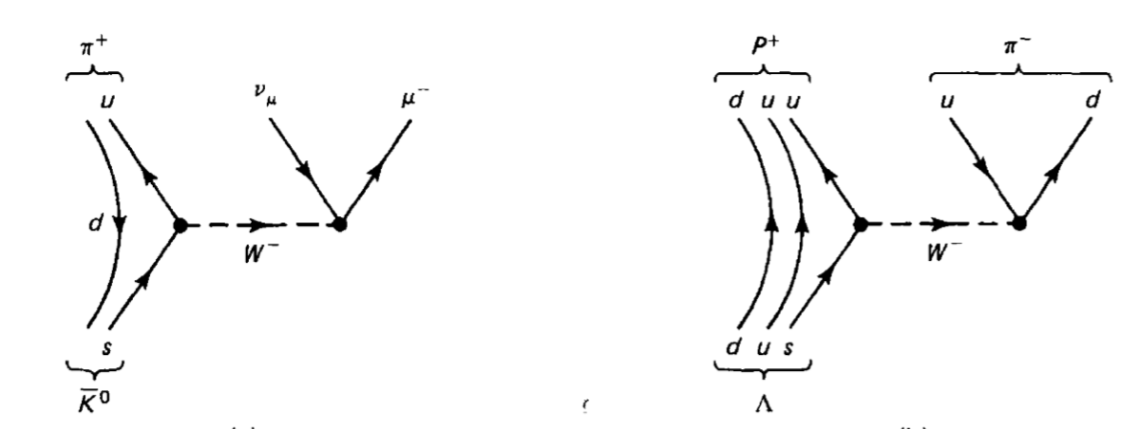
Decays
Leptonic decays
or
Semileptonic
decays
Nonleptonic
decays

Slide 7
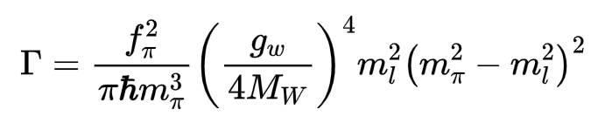

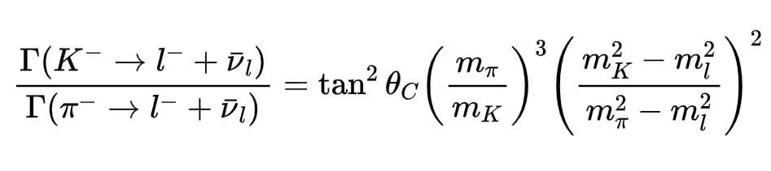
Leptonic Decays
Leptonic decays
or
Cosθ=0.97 Sinθ=0.23
Decay constant
Experiment gives Cabibbo angle 15.4°

Slide 8

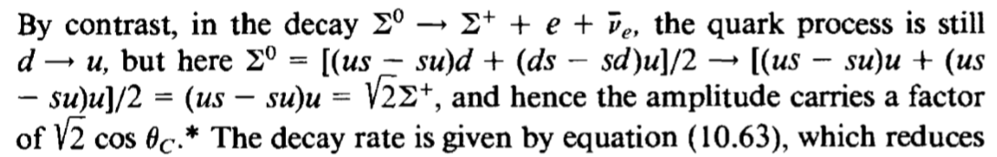
Semileptonic decays

Slide 9
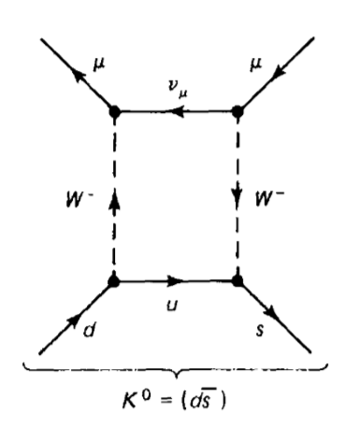
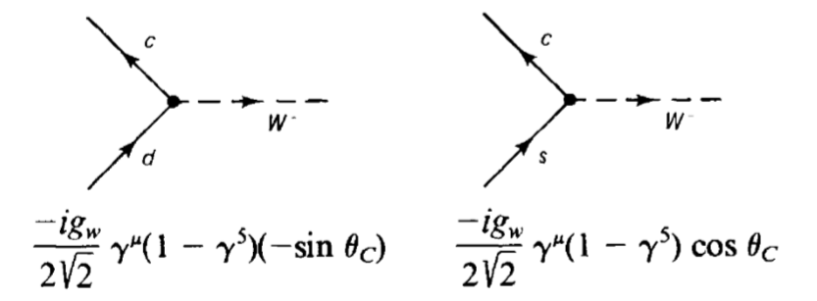
K0 Decays
Amplitude M should be proportional to CosθSinθ
Cosθ Sinθ
Experiment result is far lower?
1970 GIM mechanism introduce charm quark

Slide 10
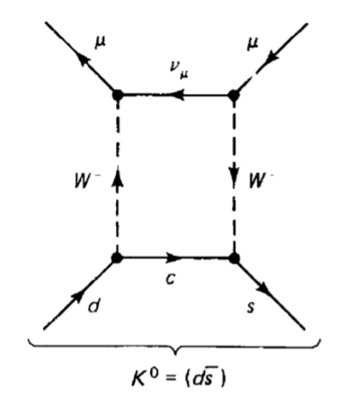
K0 Decays
1970 GIM mechanism introduce charm quark
-Sinθ Cosθ
Cosθ Sinθ
Amplitude M should be M1+M2-> A*CosθSinθ – B*CosθSinθ

Slide 11
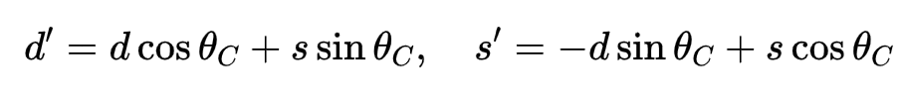
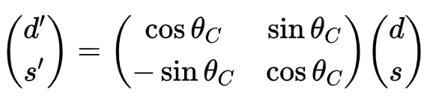
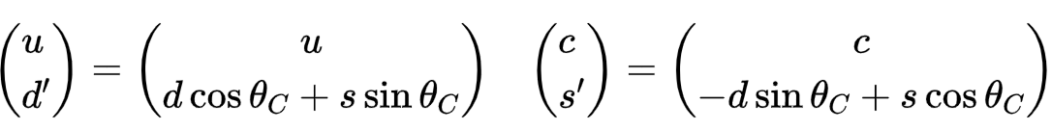
Cabibbo-GIM scheme
Weak interaction eigenstates
In matrix form
W couple with rotated state d’ s’
That is

Slide 12
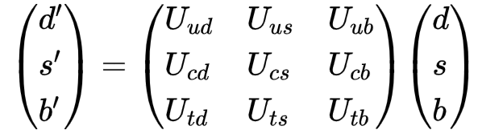
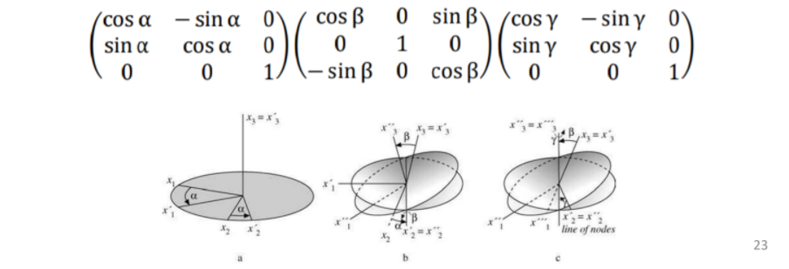

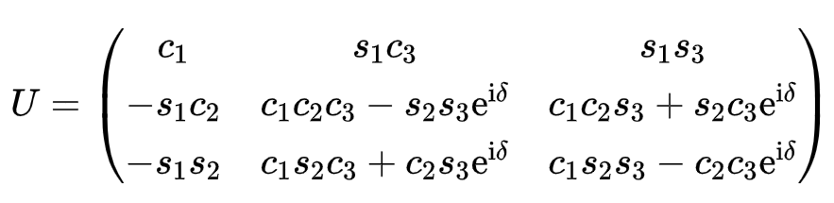



CKM Matrix
CKM Matrix
Recall that in group theory
Only 3 generalized Cabibbo angles required(θ1 θ2 θ3)

Slide 13
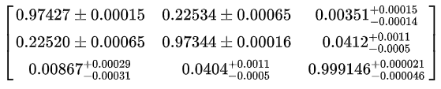
CKM Matrix
If θ2=θ3=0
Cabibbo-GIM scheme
However, experiment shows
Standard model can not predict CKM matrix

Slide 14
Neutral weak interactions

Slide 15
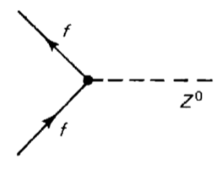



Z⁰ Boson
1985, Bludman suggested neutral weak interaction by Z0
Lepton number change
Quark generation change

Slide 16
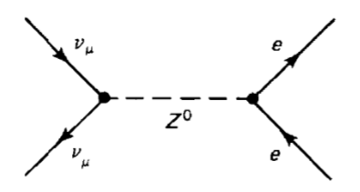

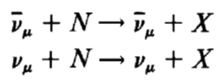
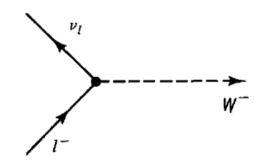
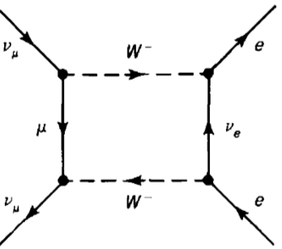
Z⁰ Boson
1973, First evidence in CERN
W+- only coupling same generation (anti)leptons and all quarks
High order process is possible (such as box diagram),while
Their cross sections were about a third as large as those charged events
Also help to establish the quark-parton model

Slide 17
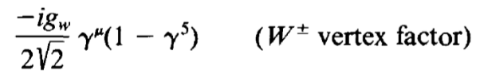

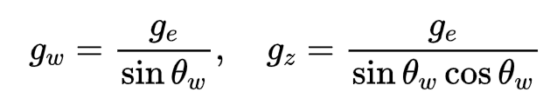
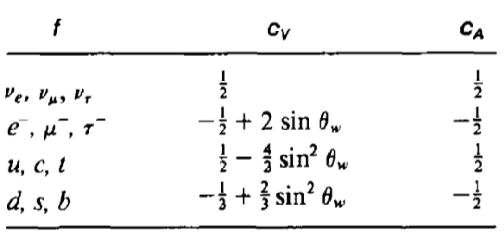
GWS model
Compare W and Z
gz is the neutral coupling constant
cV and cA depend on the quark or lepton involved
In GWS model, all determined by “weak mixing angle”

Slide 18

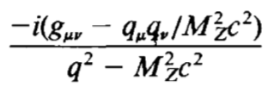

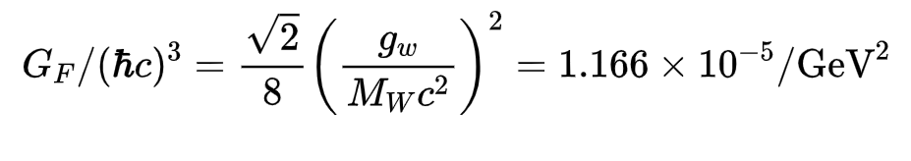
GWS model
Derivation of weak mixing angle is the main challenge of theory
Experiment gives
Propagator of Z
Finally,
These are the basic prediction of GWS model, giving mixing angle, from Fermi constant we can calculate W and Z mass

Slide 19
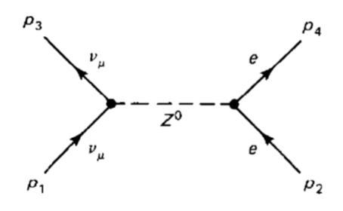

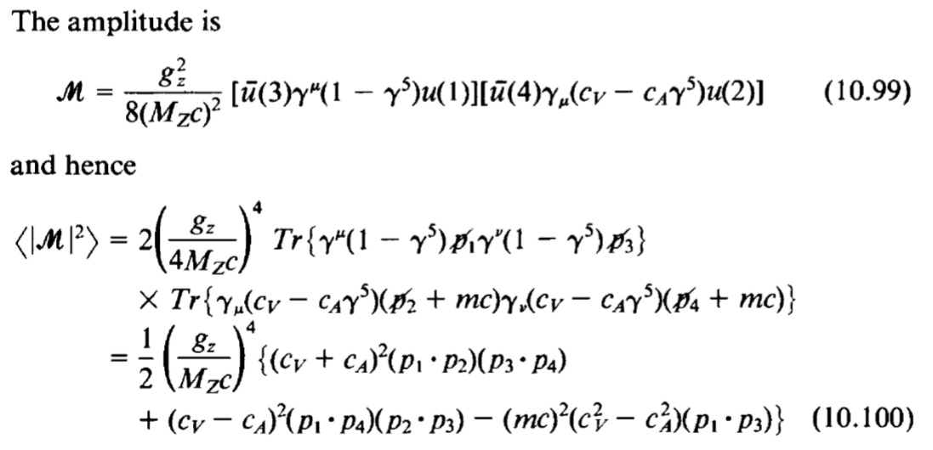
EXAMPLE Neutrino-Electron scattering

Slide 20
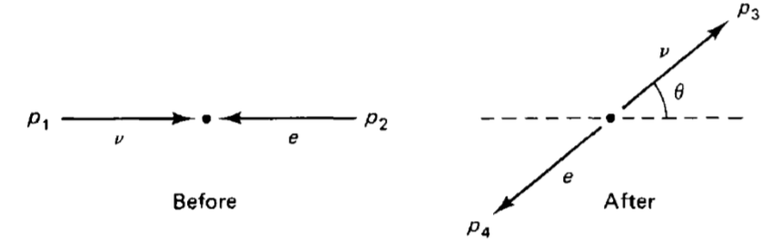
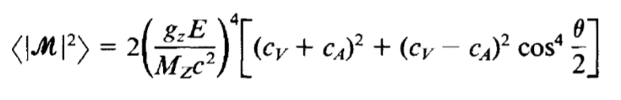
EXAMPLE Neutrino-Electron scattering
In CM frame and ignore electron mass
By using the result of two body scattering in CM frame

Slide 21
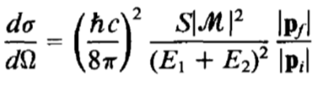
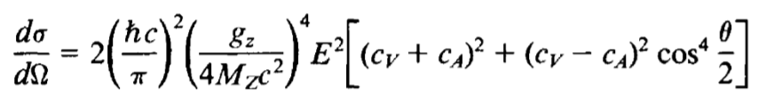
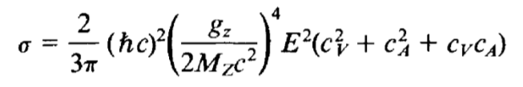
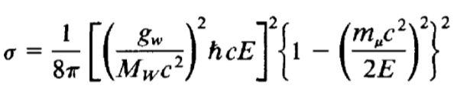
EXAMPLE Neutrino-Electron scattering
In CM frame and ignore electron mass
By using the result of two body scattering in CM frame
We get
Integrating over all angles
Insert cV and cA of electron, compare with inverse muon decay

Slide 22

EXAMPLE Neutrino-Electron scattering
Insert cV and cA of electron, compare with inverse muon decay
When E is >> mass of muon,
Experiment value is 0.08, good agreement!
Why it takes so many years to observed neutral current?
1.Masked by competing with QED process
2.Neutrino experiment is hard
3.High energy requirement because of the mass of Z

Slide 23
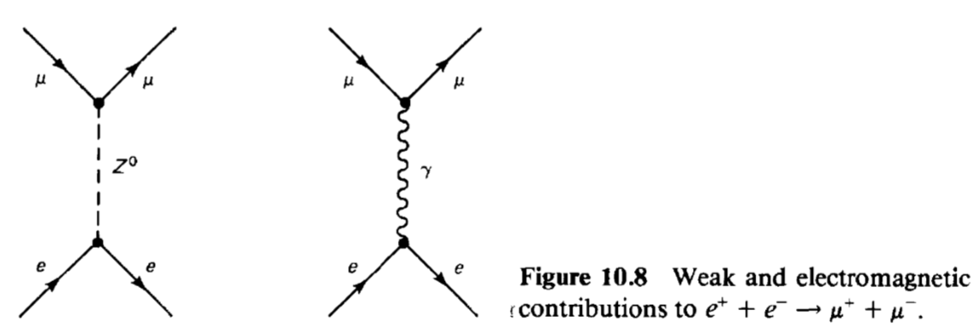
EXAMPLE Neutrino-Electron scattering
Why it takes so many years to observed neutral current?
1.Masked by competing with QED process
2.Neutrino experiment is hard
3.High energy requirement because of the mass of Z
Z couples everything the photon does
Every QED process contains weak interaction part!

Slide 24
EXAMPLE Neutrino-Electron scattering
Why it takes so many years to observed neutral current?
1.Masked by competing with QED process
2.Neutrino experiment is hard
3.High energy requirement because of the mass of Z
Propagator of Z
If q=Mz?
Requires 90GeV
Next time, Electron-Positron Scattering Near the Z° Pole

Slide 25
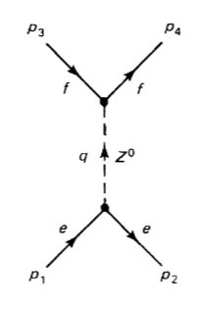
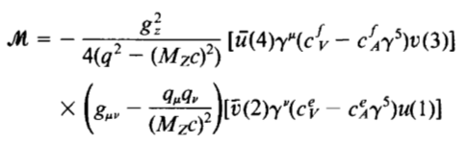


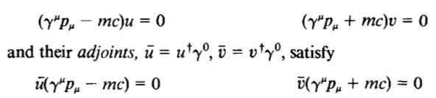

EXAMPLE Electron-Positron Scattering
Consider electron-positron scattering around Z0 pole
Because q is large, so we can neglect lepton
and quark mass, in this case, the second term is 0
From Dirac equation, we find

Slide 26
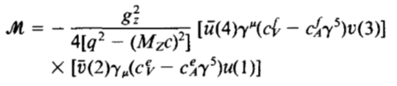
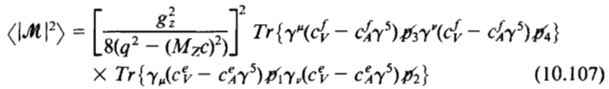
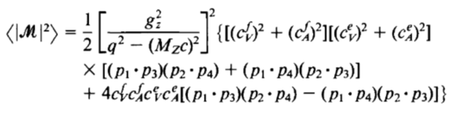
EXAMPLE Electron-Positron Scattering
The amplitude can be simplified as
Apply trace theorem

Slide 27



EXAMPLE Electron-Positron Scattering
In the CM frame
Finally, the differential cross section
And the total cross section

Slide 28



EXAMPLE Electron-Positron Scattering
As it shows, when 2E= Mc^2, it goes to infinity
But Z boson is not a stable particle, so it is not always on the mass shell so we can modify the propagator:
The cross section becomes
The correction term is negligible only when E=Mc^2

Slide 29



EXAMPLE Electron-Positron Scattering
In the previous chapter, we calculate the cross section of electron-positron scattering
Where Q denotes the charge, the only difference is the meditator, so we can write the ratio of the two process
Which has same products-muon

Slide 30



EXAMPLE Electron-Positron Scattering
The factor in the curly bracket is approximately 2 if we use the weak mixing angle, and if the energy is << Mc^2
The electromagnetic route dominates, but right on the Z pole
$ℏΓ_{z}$is around 2.5GeV, so the ratio is 200

Slide 31
Electroweak Unification

Slide 32
Chiral Fermion States
Glashow’s difficulty
1. Enormous disparity in strength between weak and electroweak interaction?
Because of the extremely massive mediator
2. Why the two mediators differ from each other so much?
Higgs mechanism
3. The structure difference between the vertex factors
Absorbing the matrix $1−γ^{5}$ into the particle spinor itself.

Slide 33




Chiral Fermion States
Specifically, we define
Chirality, which is different from “Helicity” we learned before,
It is easily to show that
If the particle is massless, $E=\left|P\right|c$
Where

Slide 34





Chiral Fermion States
If the particle is massless, $E=\left|P\right|c$
Accordingly,
$\frac{1}{2}\left(1−γ^{5}\right)$ is projection operator which pick out only left hand component, for antiparticles,
We define
The corresponding right-handed

Slide 35



Chiral Fermion States
The corresponding right-handed
Also for Dirac adjoint spinors, we have
As summarized

Slide 36



Chiral Fermion States
Consider, to begin with, the coupling of an electron and a neutrino to the W-
The contribution to M from this vertex is given by
This quantity is called the (negatively charged) weak current,and

Slide 37


Chiral Fermion States
By using the property of $γ^{5}$
We get
According to previous discussion of chirality,
Now the vertex is purely vectorial ，but only
Only left handed left

Slide 38



Chiral Fermion States
While QED can couple both left and right handed component
However, we can play a same trick to spinors:
So the electromagnetic current can be written in terms of chiral spinors
The cross term disappear because
We moved one step forward

Slide 39





Weak isospin and Hypercharge
We can express them into one left-handed doublet
And 2x2 matrices
These two matrices are linear combination of two Pauli matrices

Slide 40

Weak isospin and Hypercharge
The reason of using τ instead of σ is that we are talking about isospin now
We have a τ3 left and the neutral current left, so….
One question is that Z boson couples both left and right components, but this “current” only involves left one
Building on the parallel with isospin, we are led to consider a weak analog of hypercharge (Y)

Slide 41






Hypercharge
By Gell-Mann Nishijima formula
From this, we introduce the weak hyper charge current
This is an invariant construct, The underlying symmetry is $SU{\left(2\right)}_{L}⊗U\left(1\right), SU{\left(2\right)}_{L}$ represent weak isospin, $U\left(1\right)$ represent weak hypercharge
Extend it to the other leptons and quarks
We construct three weak isospin currents
And a weak hypercharge

Slide 42




Electro-Weak Mixing
Three weak isospin currents couple, with strength gw, to a weak isotriplet of intermediate vector bosons, W,
whereas the weak hypercharge current couples with strength g'/ 2 to an isosinglet intermediate vector boson, В:
Within this fundamental structure is contained all of electrodynamics and all of the weak interactions.
The dot product can be written out:
or, in terms of the charged currents,

Slide 43



Electro-Weak Mixing
or, in terms of the charged currents,
The vertex factor is
But the symmetry is broken in GWS theory, the two neutral states W3 and B mix, producing one massless linear combination(photon) and a massive combination Z

Slide 44




Electro-Weak Mixing
This is why θ is called mixing angle
And the neutral portion of the electro-weak interaction reads
The electromagnetic coupling in the present language is
Comparing with the previous one
They are not independent

Slide 45

Electro-Weak Mixing
By the 3 following equations
We get

Slide 46

Electro-Weak Mixing
From this, we have the neutral current
Why the underlying symmetry of the electroweak interactions “broken”
Why do the В and W3 states “mix” and form the Z° and the photon?

